Slide 1
Transformers Learn In-Context by Gradient Descent
Max Vladymyrov, Google Research
in collaboration across Google Research and ETH (Zurich):
Johannes von Oswald, Eyvind Niklasson, Maximilian Schlegel, Joao Sacramento, Seijin Kobayashi, Nicolas Zucchet, Alexander Mordvintsev, Andrey Zhmoginov, Blaise Agüera y Arcas, Ettore Randazzo, Mark Sandler, Nolan Miller, Razvan Pascanu

Slide 2
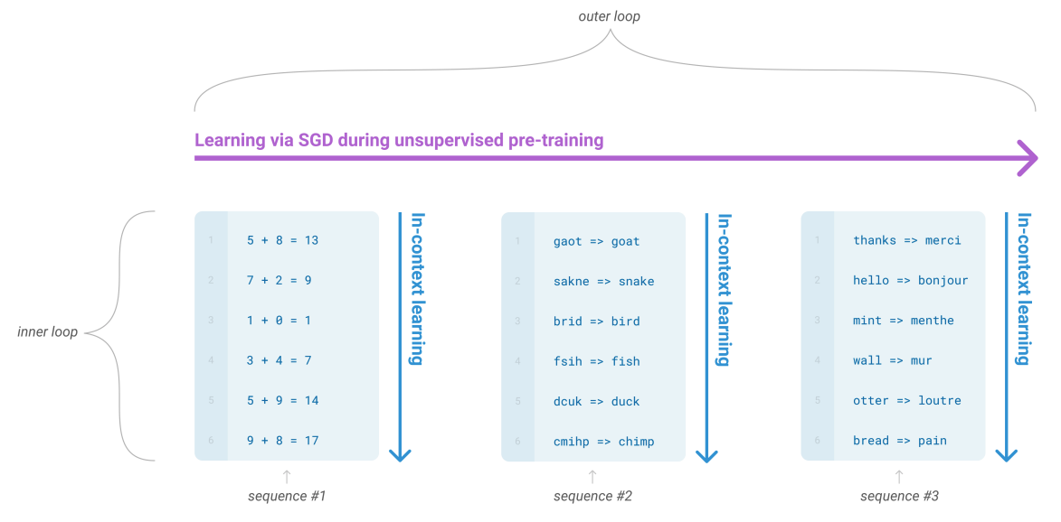
In-context learning
First observed in GPT-3 paper from OpenAI:
Language Models are Few-Shot Learners

Slide 3
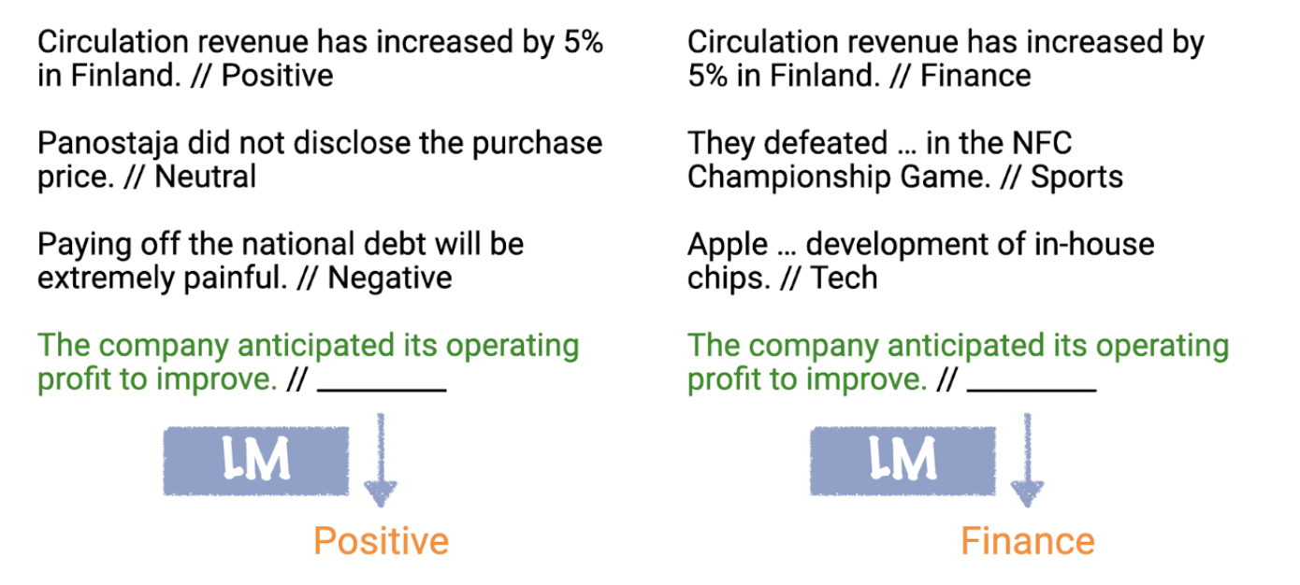
In-context learning
In lay terms, it seems like LLMs are able to “get it” what user wants them to do from the few-shot demonstrations.
Towards Understanding In-context Learning
Notes:
No weight update and model is not explicitly pre-trained to learn from examples

Slide 4
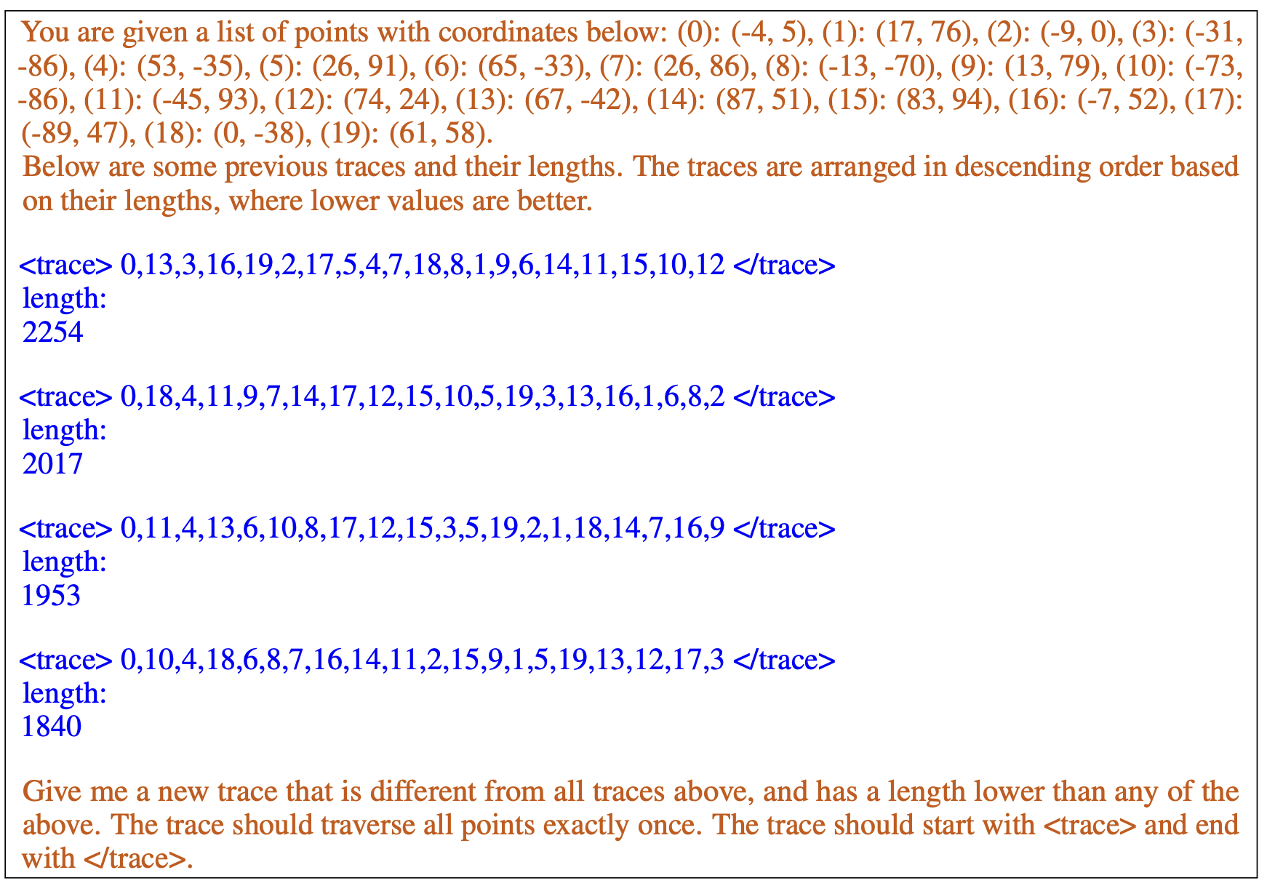
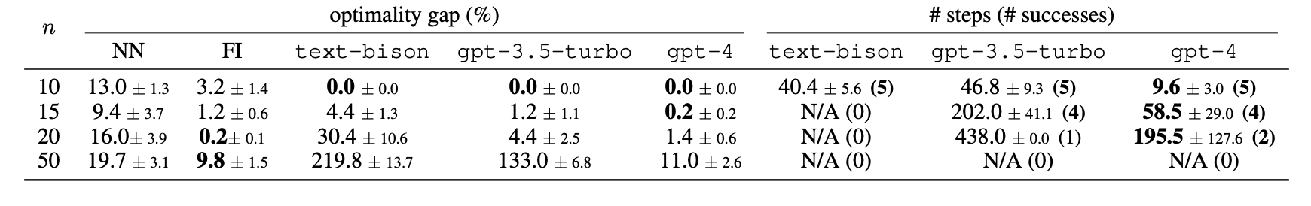
In-context learning
Transformers can approximately solve Traveling Salesman Problem out of the box:
Large Language Models as Optimizers

Slide 5
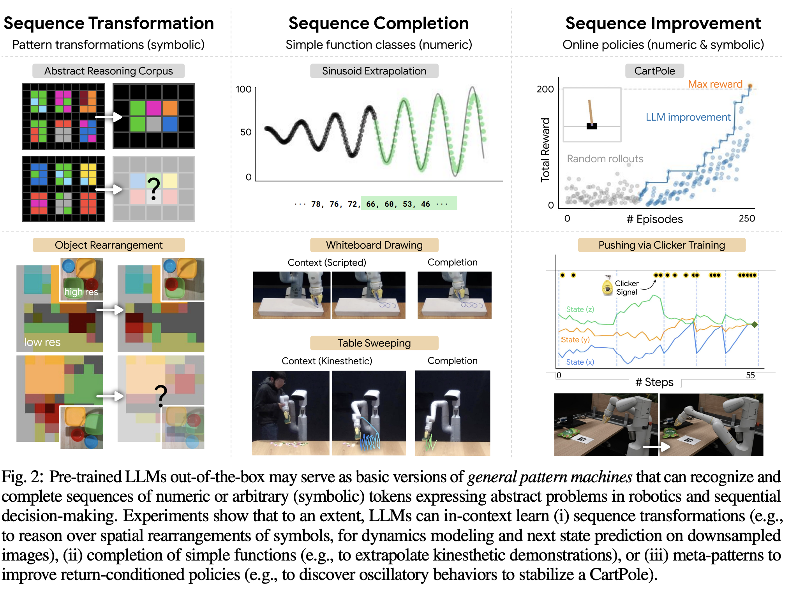
In-context learning
Large Language Models as General Pattern Machines

Slide 6
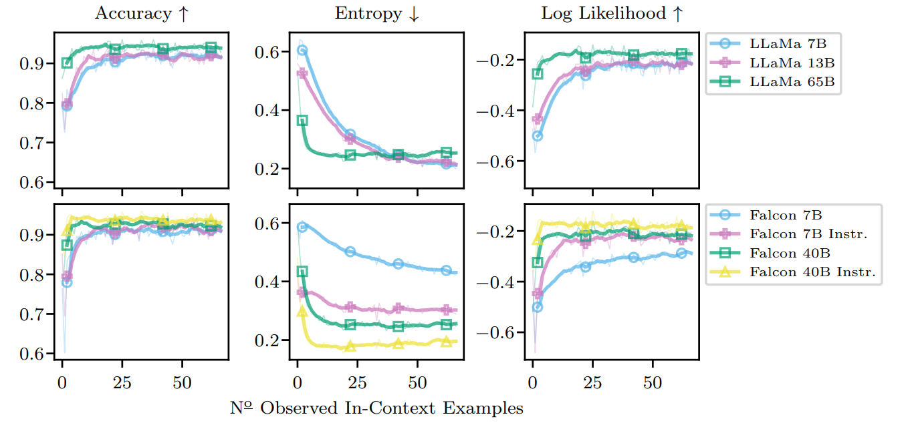
In-context learning
Not just the Accuracy improves, but the also the Entropy and the Log Likelihood suggest an underlying in-context loss function.
In-Context Learning in Large Language Models Learns Label Relationships but Is Not Conventional Learning

Slide 7
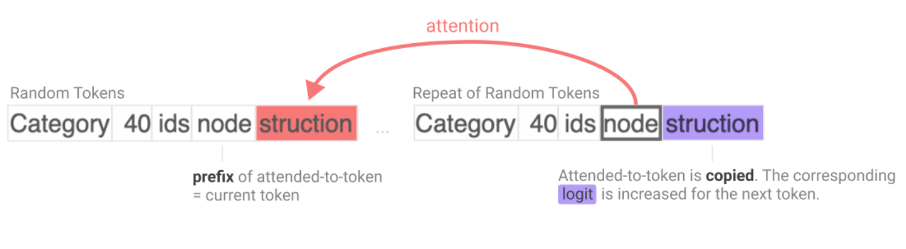
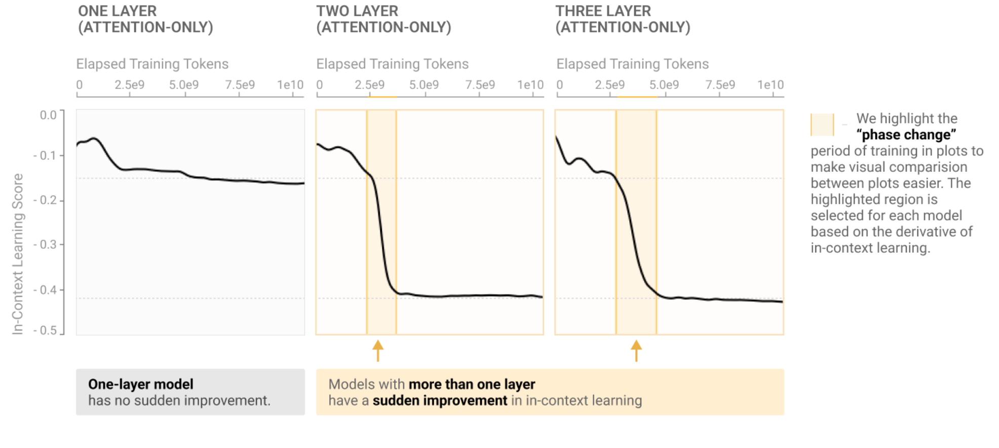
Induction heads
“The first attention head copies information from the previous token into each token.
This makes it possible for the second attention head (which we call the "induction head") to attend to tokens based on what happened before them, rather than their own content.
That is, the two heads working together and cause the sequence …[A][B]…[A] to be more likely to be completed with [B].”
In-context Learning and Induction Heads

Slide 8
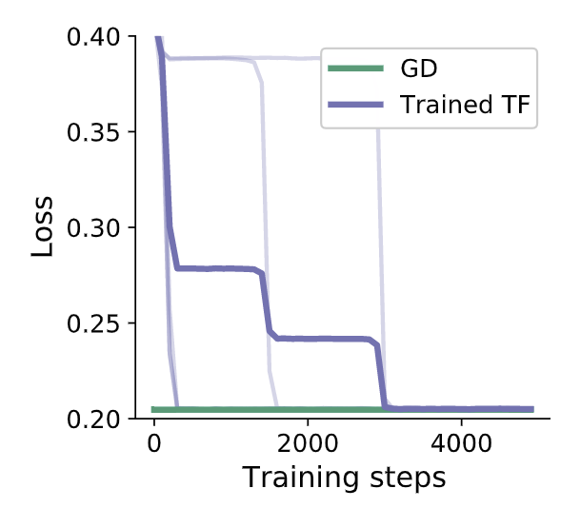
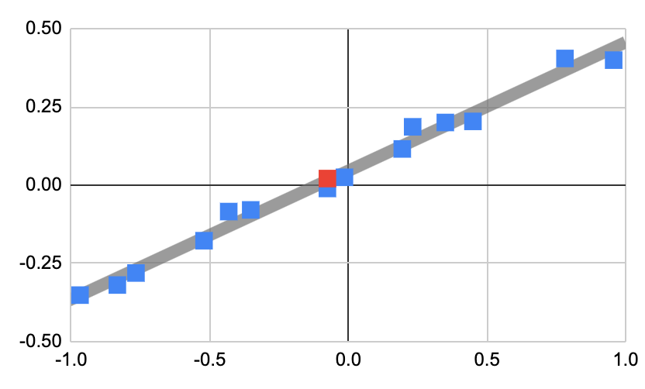

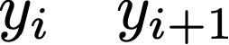

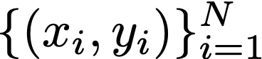
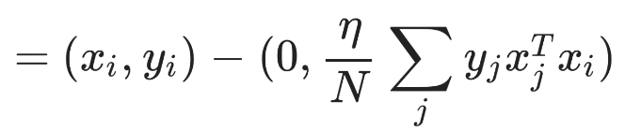
Transformers learn in-context by gradient descent
Gradient descent by SA-layer
Task: Attention layer learns linear model on training data and predicts on test data .
A single linear self-attention layer can implement a single gradient descent step on squared error loss and this solution is optimal:
Multiple linear self-attention layers can implement a preconditioned gradient descent.
Transformers learn in-context by gradient descent

Slide 9
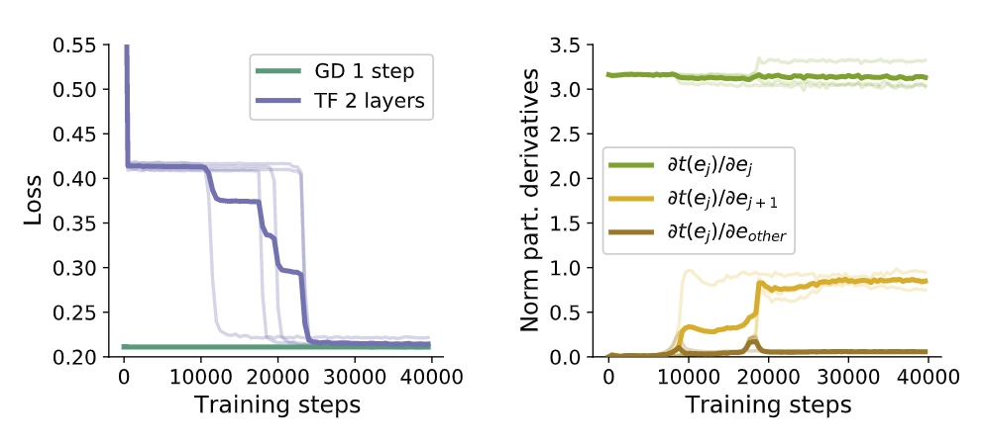

Transformers learn in-context by gradient descent
GD by linear SA-layer
Copy by softmax SA-layer
First softmax attention layer copies token data to construct linear regression loss, similar to the induction heads by Olsson et al. (2022).
Transformers learn in-context by gradient descent

Slide 10
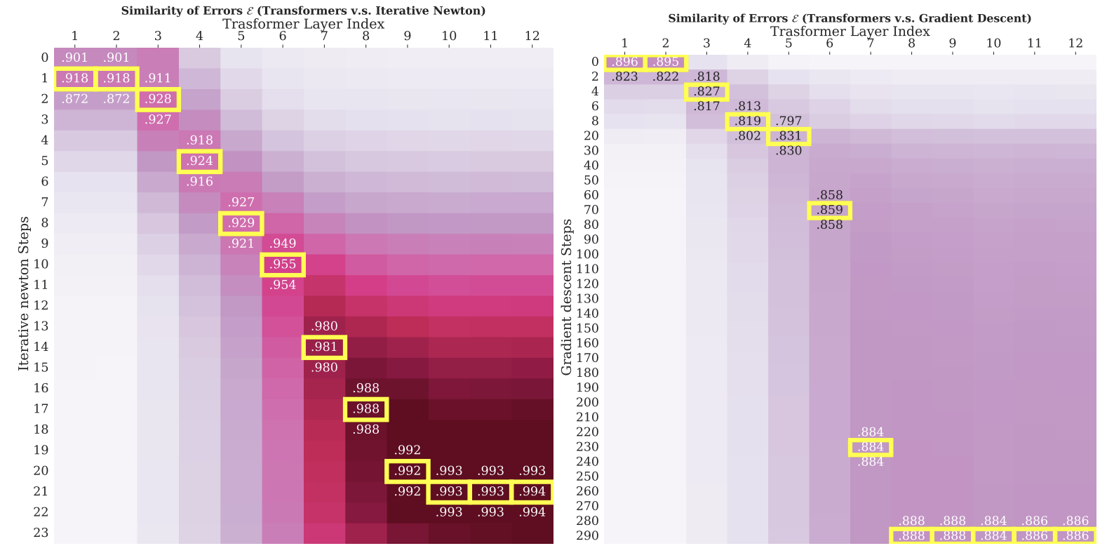
Higher-order optimization
12 layer attention (with softmax and MLPs) approximates Iterative Newton's Method.
Transformers Learn Higher-Order Optimization Methods for In-Context Learning: A Study with Linear Models

Slide 11
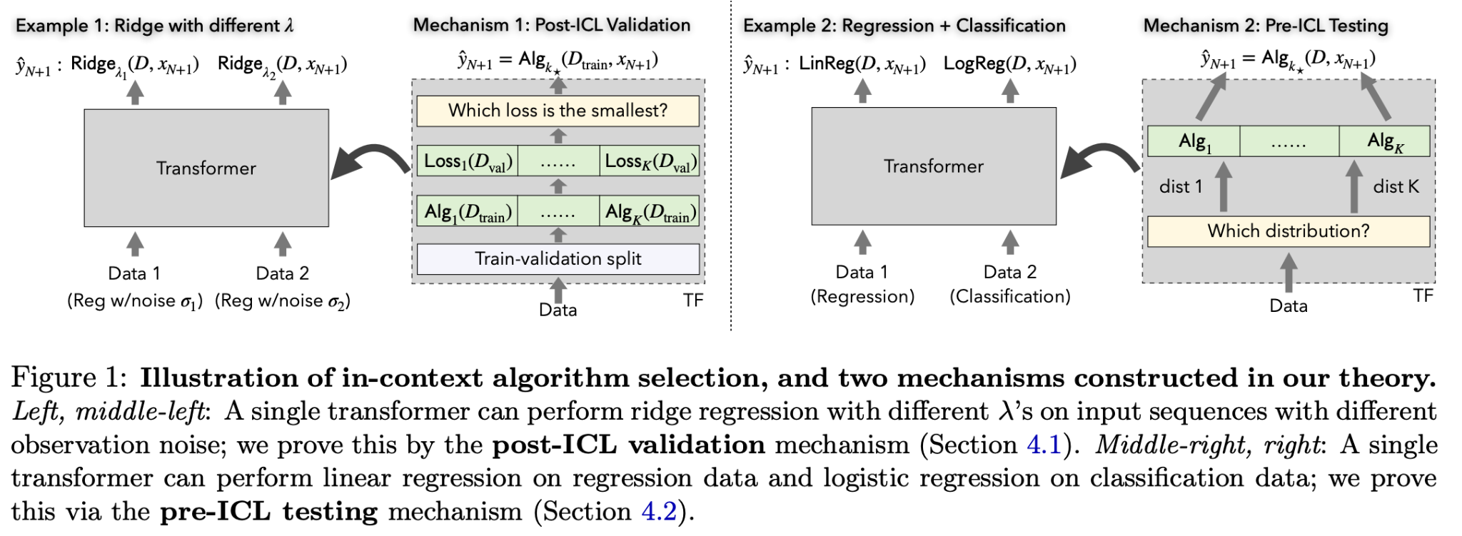
Transformers as Statisticians
Transformers also can learn classification tasks and even learn multiple tasks simultaneously.
Transformers as Statisticians: Provable In-Context Learning with In-Context Algorithm Selection

Slide 12

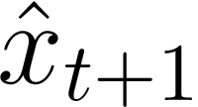

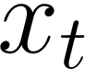
In-contexts autoregressive learning
Task: in-context supervised learning
Task: sequence prediction
?
Transformer
Transformer
Uncovering Mesa-Optimization Algorithms in Transformers

Slide 13
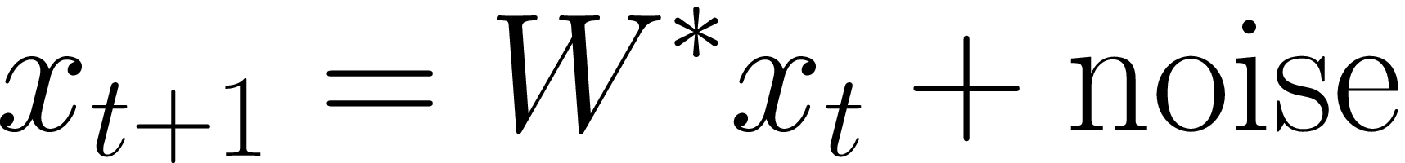
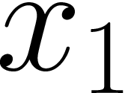
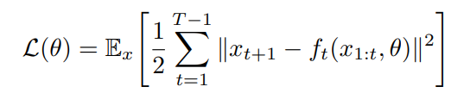
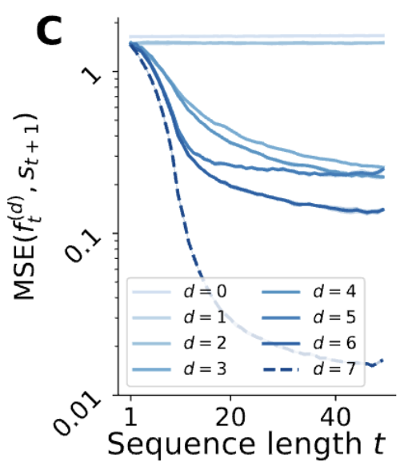
In-contexts autoregressive learning
For a linear dynamical systems
with random orthogonal and a random normal initial state , minimize:
Similar to the supervised learning, Transformers can be shown to learn using a gradient-based learning algorithm.
Transformer
Uncovering Mesa-Optimization Algorithms in Transformers

Slide 14
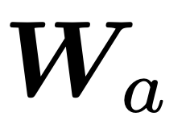

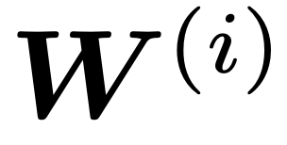
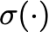
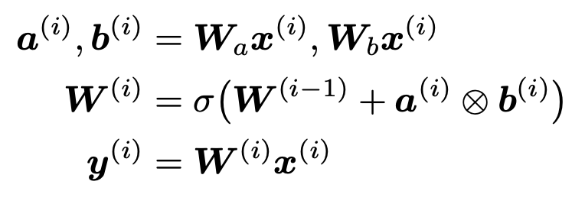
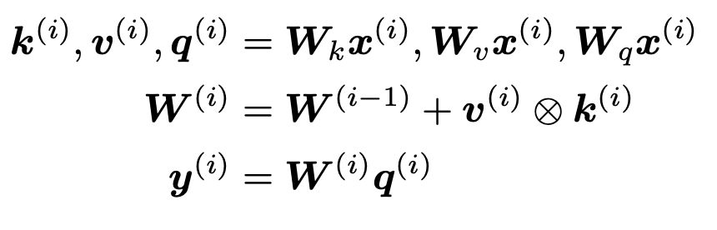
What is actually going on?
Direct connection between linear Transformers and Fast Weight Programming
For and as frozen trained slow weights, the fast weights are generated at each time step as:
Which can be equivalently rewritten as a linear self-attention with identity activation function :
Linear Transformers Are Secretly Fast Weight Programmers
Notes:
The analogy is striking

Slide 15
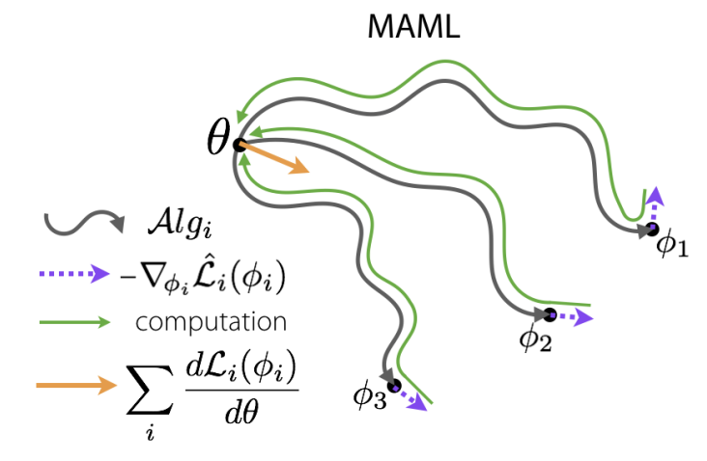
Meta vs mesa learning?
Meta-learning (from Latin for “above”):
Clearly defined outer and inner loop, with explicit inner loss function.
Interpretable search space.
Example: Learning to learn (e.g. hyperparameter tuning), MAML.
Mesa-learning (from Latin for “below”):
Implicit loss function, with “emergent” inner learning behaviour.
Hard to interpret, grokking effects.
Example: Nature evolution that gives rise to intelligent machines (aka humans).
?
Risks from Learned Optimization in Advanced Machine Learning Systems
Notes:
First introduced in the alignment community

Slide 16
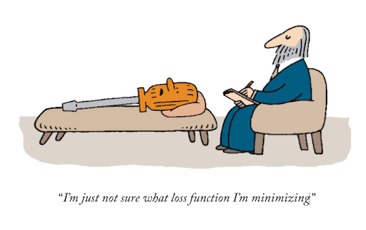
A case against a global loss function
We minimize multi-billion LLM models based on single perplexity/reward score.
But the intelligence is not about optimizing a scalar loss functions, such as a perplexity, reward, etc.
Does human brain have a loss value? What about stock market, scientific process?
Can we assign an ordinal value to morality, love?

Slide 17
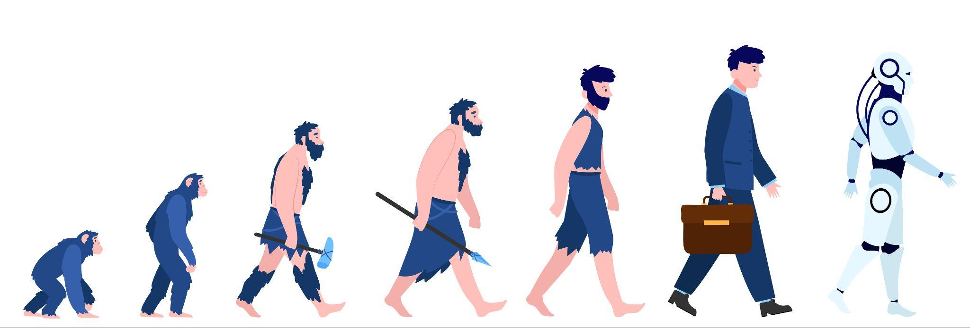
A case for a global loss function
However, it might not be that hard to assign a global scalar loss to a general process of Nature’s evolution (e.g. expectation of reproductive fitness per species).
It just might be that the global loss is enough to help develop a general mesa-learning capabilities:
Humans need to eat meat to increase their fitness.
Humans hunt for meat, so they can eat and increase their fitness.
Humans learn to be a hunter, so they can hunt for food, so they can eat and increase their fitness.

Slide 18
Conclusions
In-context learning is powerful, yet poorly understood.
Early signs suggest Transformers can emulate a learning algorithm during training.
We need to bridge the gap between empirical evidence of the in-context learning of LLMs and more theoretical evidence of the smaller Transformers trained on the linear regression tasks.
Hypothesis: modern LLMs likely optimize in-context learning by constricting and minimizing a (hierarchical) set of implicit loss functions.
Future research likely to explore implicit bi-level or multi-level optimization nature of in-context learning and make it explicit.

